Slide 1

Remote Patient Care: Health Monitoring and Adherence with AWS and IoT.

Slide 2

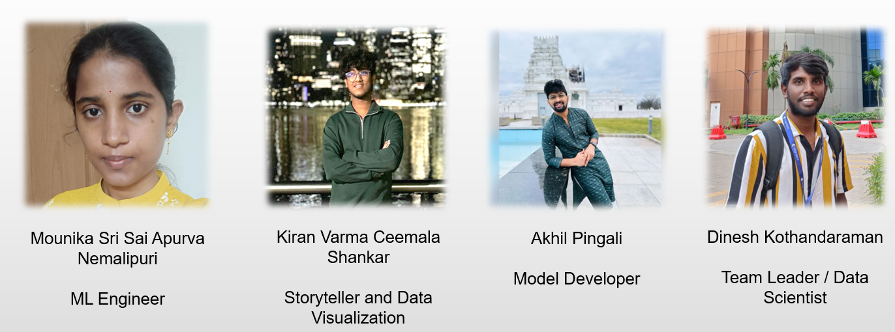
Team-12
Team-12

Slide 3

Brief Overview
Section 1: Challenges in Remote Patient Care
Section 2: Innovative Solutions with IoT Integration
Section 3: Data Pipeline Development with CRISP-DM Model

Slide 4
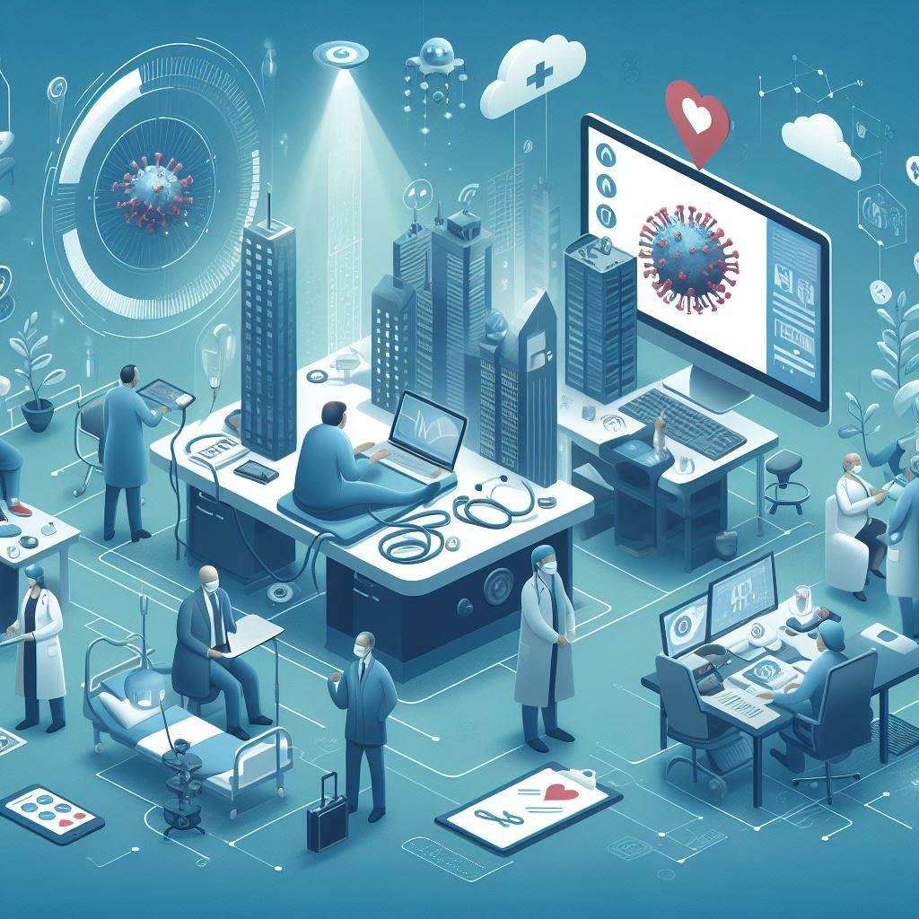
Problem Statement: How can healthcare organizations effectively deliver remote patient care services?
Let's address main challenges:
Difficulty in Remote Adherence: Ensuring patient adherence to treatment plans remotely poses a significant challenge for healthcare providers. Without direct supervision, it's challenging to ensure that patients are following their prescribed regimens, leading to potential health risks and complications.
Challenges in Real-time Health Monitoring: The inability to monitor real-time health metrics remotely creates a gap in the comprehensive understanding of a patient's health status. This lack of real-time data can hinder timely interventions and proactive healthcare management.
Impact: Effective remote adherence monitoring is essential for maintaining patient health, preventing complications, and optimizing healthcare resources. It's a critical aspect of remote patient care that requires innovative solutions.

Slide 5

The need for Proactive Issue Identification and Resolution.
Challenges in Proactive Issue Identification:
The lack of mechanisms for proactive identification and resolution of emerging health issues presents a significant obstacle in remote patient care. Without proactive measures, healthcare providers may struggle to address potential health complications in a timely manner.
Importance of Proactive Resolution:
Proactive issue resolution is crucial for preventing health crises, reducing hospitalizations, and improving overall patient outcomes. It's an essential component of effective remote patient care that requires innovative solutions and advanced technologies.

Slide 6

Innovative Solutions with IoT Integration.

Slide 7
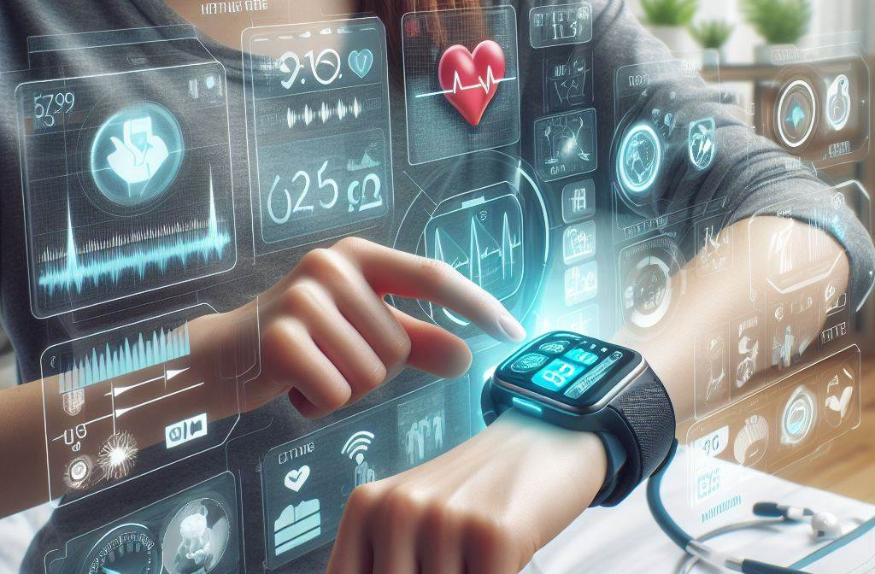
Implementing Wearables for Health Metric Monitoring
Real-time Health Data Collection: Wearable devices enable continuous, real-time monitoring of vital signs and health metrics, providing healthcare providers with a comprehensive view of a patient's health status. This data empowers timely interventions, early detection of health issues, and personalized care management.
Integration with Remote Care Systems: The integration of wearable devices with remote care systems enhances the overall effectiveness of remote patient care, enabling seamless data transmission, actionable insights, and improved healthcare decision-making.
Empowering Patients: Wearable technology empowers patients to actively monitor their health metrics, fostering a sense of control and awareness. This proactive approach to health management can lead to improved patient outcomes and a more proactive patient population.

Slide 8
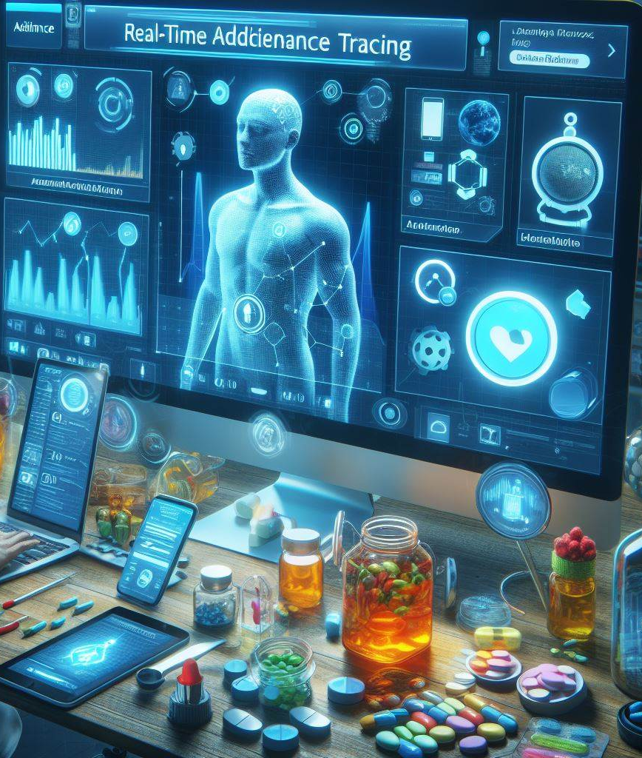
Utilizing IoT Devices for Adherence Tracking.
Real-time Adherence Tracking: Leveraging IoT devices for real-time adherence tracking enables healthcare providers to monitor patient compliance with treatment plans remotely. This technology offers insights into patient behavior and adherence patterns, facilitating proactive interventions and personalized care.
Enhanced Patient Engagement: IoT integration fosters patient engagement by providing individuals with tools to actively participate in their care. This can lead to improved adherence, better health outcomes, and a more collaborative patient-provider relationship.
Impact on Healthcare Efficiency: The use of IoT devices for adherence tracking can streamline healthcare operations, optimize resource allocation, and reduce the burden on healthcare providers, ultimately improving health care delivery.

Slide 9
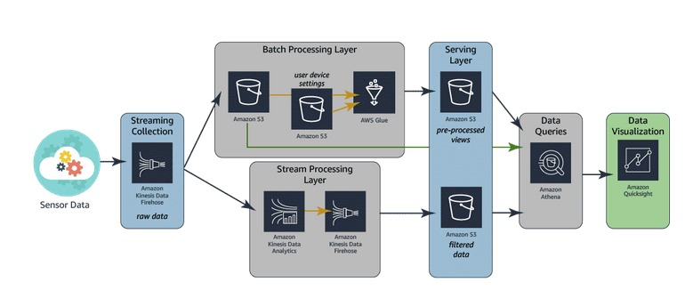
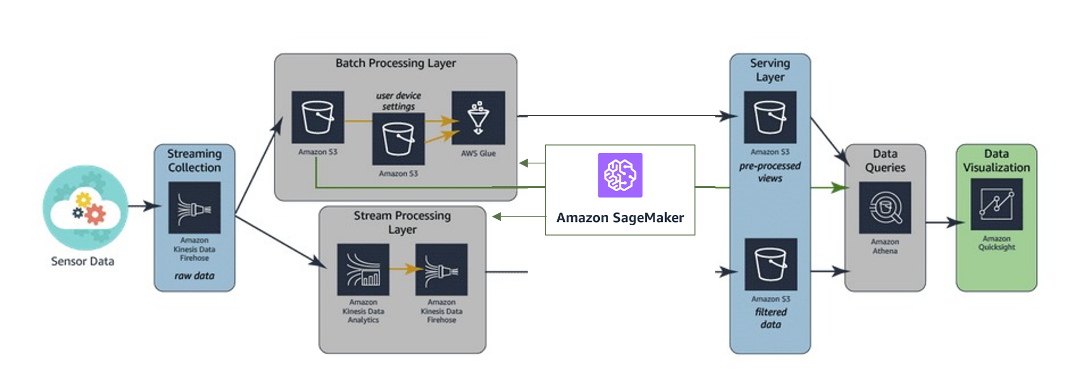
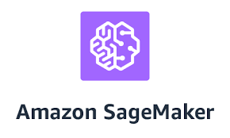
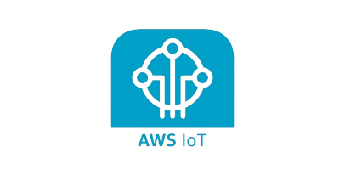
Our Data Pipeline

Slide 10
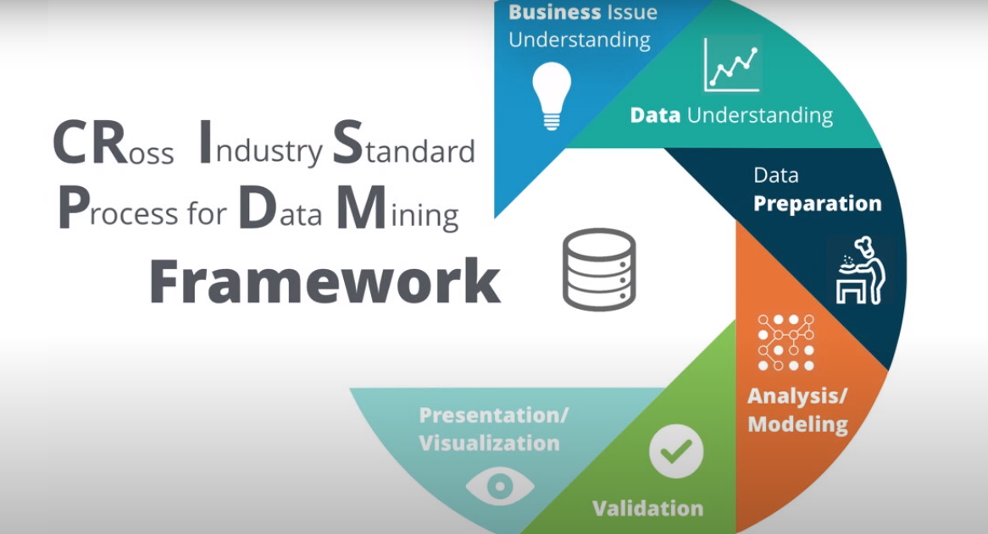

Slide 11

Business Understanding
Objective of Remote Patient Monitoring: The objective is to implement a remote patient monitoring and treatment adherence system using AWS IoT Analytics, aiming to enhance patient care through real-time health data monitoring, timely interventions, and improved treatment adherence.
Stakeholders and Goals: The stakeholders include patients, healthcare providers, system administrators, and AWS IoT Analytics developers, with the goal of delivering value through effective remote patient care solutions.

Slide 12

Data Understanding and Preparation
Data Sources and Exploration: Patient health data from IoT devices, including vital signs, medication adherence, and activity levels, are collected from AWS IoT and S3. Data exploration involves analyzing data types, sources, quality, and patterns to understand the information scope.
Data Requirements: Define necessary attributes, collection frequency, and regulatory considerations.
Data Collection, Cleaning, and Integration: Secure data transmission, data cleaning, and data integration are essential steps to ensure data quality and uniformity for effective analysis and modeling.

Slide 13

Modeling and Evaluation
Feature Engineering and Model Selection: Feature engineering involves deriving relevant features, and model selection entails choosing appropriate models, such as anomaly detection or predictive models, using AWS Glue and Amazon Sage Maker.
Model Training and Evaluation:
Model Performance: Assess accuracy, precision, recall, and F1-score metrics (Amazon Sage Maker).
Business Impact: Evaluate model predictions' potential impact on patient health and adherence rates.
Feedback: Collect feedback for model refinement from healthcare providers and patients.

Slide 14

Leveraging Machine Learning for Proactive Health care delivery.
Predictive Analytics for Health Monitoring: Machine learning algorithms can analyze real-time health data to identify patterns, trends, and potential health risks. This proactive approach to health issue identification enables early intervention, personalized care plans, and improved patient outcomes.
Personalized Care Recommendations: Machine learning models can generate personalized care recommendations based on individual health data, optimizing treatment plans and interventions. This tailored approach to healthcare can enhance patient adherence and overall health management.
Empowering Healthcare Providers: Machine learning empowers healthcare providers with advanced tools for predictive health monitoring, enabling them to proactively address emerging health issues, reduce complications, and optimize resource allocation.

Slide 15

Deployment & Monitoring
System Integration, User Training and Monitoring.
Integrating Models into AWS IoT Analytics for real-time monitoring, providing training and documentation for healthcare providers, and establishing mechanisms for tracking system performance and user feedback.
Monitoring: Establish mechanisms for tracking system performance, data integrity, and user feedback (CloudWatch, AWS IoT Analytics).

Slide 16
THANK YOU!
This is Our Github Repository!
https://github.com/Dinesh-Kothandaraman/DSCI-6007-03-Team12.git

